Slide 1
BUILDING A BRIDGE OF FRIENDSHIP

Slide 2
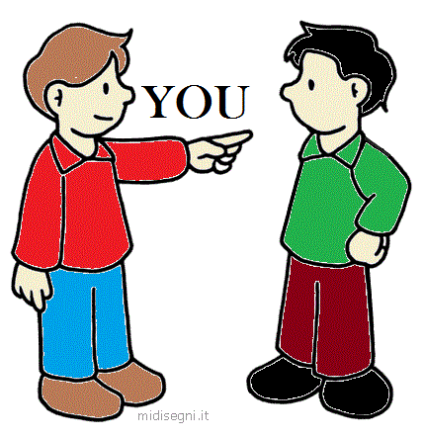
us/we
me

Slide 3
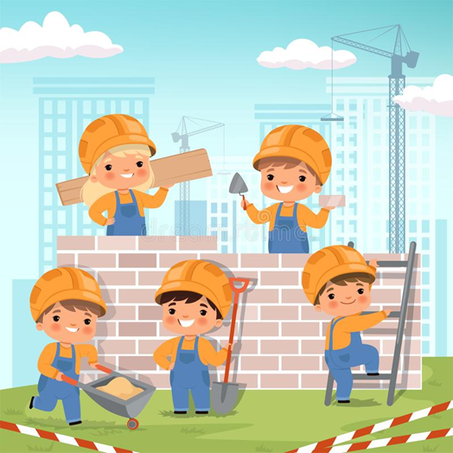
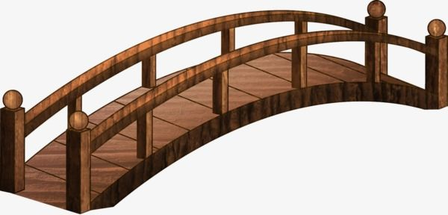
building (to build) a bridge

Slide 4
A BRIDGE OF FRIENDSHIP
It‘s
me,
I‘m
building
a bridge
of
friendship
It‘s
you,
you‘re
building
a bridge
of
friendship
It‘s
us,
we‘re
building
a bridge
of
friendship

Slide 5
You
can
go
everywhere,
you
can
go
around,
but
in
your
heart
you‘re
building a bridge of friendship.

Slide 6
It's me, it's me, I'm building a bridge of friendship,
It's me, it's me, I'm building a bridge of friendship,
It's me, it's me, I'm building a bridge of friendship,
I'm building a bridge of friendship.
You can go everywhere, you can go around,
But in your heart your're building a bridge of friendship.
You can go everywhere, you can go around,
But in your heart your're building a bridge of friendship.
It's you, it's you, you're building a bridge of friendship,
It's you, it's you, you're building a bridge of friendship,
It's you, it's you, you're building a bridge of friendship,
You're building a bridge of friendship.
You can go everywhere, you can go around…
It's us, it's us, we're building a bridge of friendship,
It's us, it's us, we're building a bridge of friendship,
It's us, it's us, we're building a bridge of friendship,
we're building a bridge of friendship.
You can go everywhere, you can go around…

